Slide 1


Convolutional Neural Network Forest for Predicting Commodity Futures Contract movements
Jan 2024

Slide 2
Target audience is tech savvy investors
Somewhat of a sales pitch.
Practice, hopefully inspirational for Affor.

Slide 3
Inspiration from Alpha Go
A game as complex as chess (and Go), convincingly solved by a CNN Architecture
I assume the market is also very complex.

Slide 4
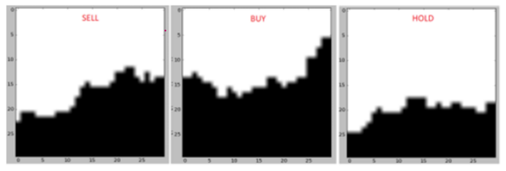
Previous papers
This paper had good results with just showing a cnn 1 dimensional graphs.
Pretty good results, but so much space is wasted.

Slide 5
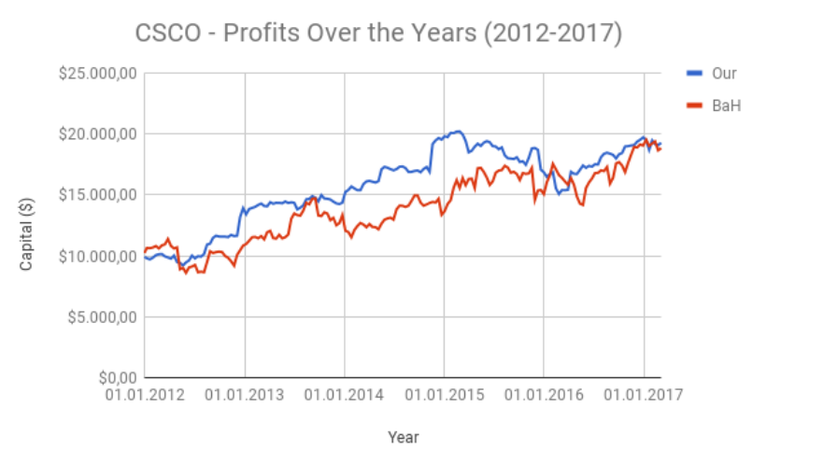
Results of mentioned CNN
Generally just outperforms Buy and Hold in the backtests they showed.

Slide 6
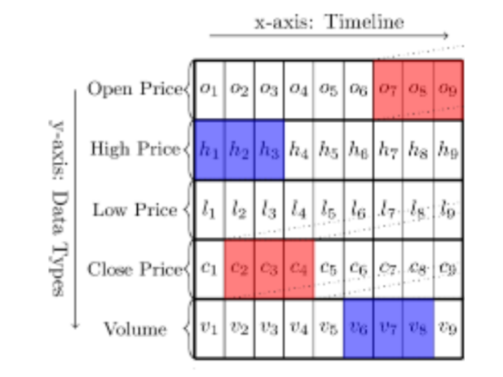
The next paper does improve on using space more optimally
Even Though this method is more parameter efficient, the vertical dimension makes no sense, rendering it useless.

Slide 7
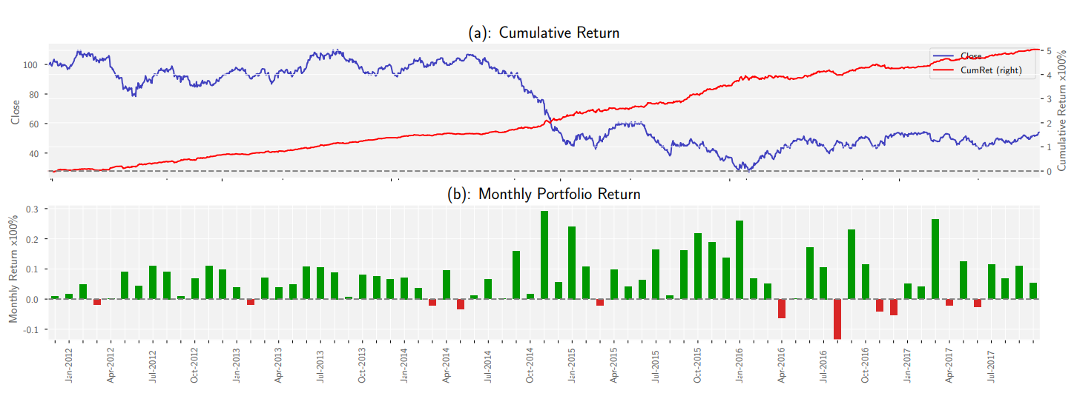
Results of mentioned CNN

Slide 8
Why a CNN is a very good method for predicting commodity data
Enhanced feature engineering capabilities with convolutions and parameters.
main reason over other network types
Inherently good at handling time series data.
not all networks have this capability

Slide 9
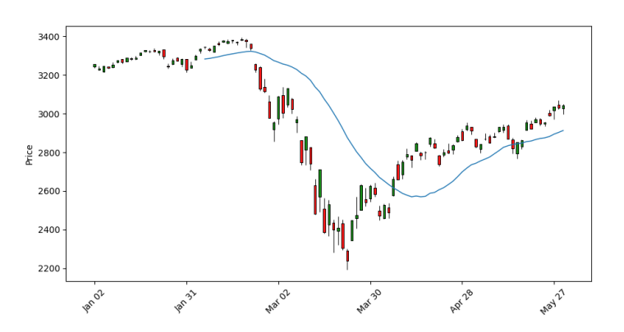
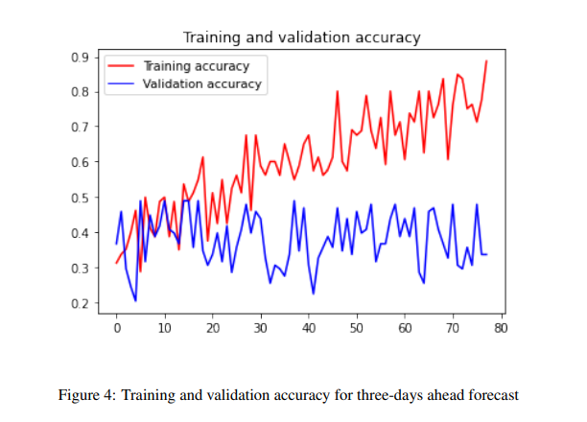
CNN does not work out of the box

Slide 10
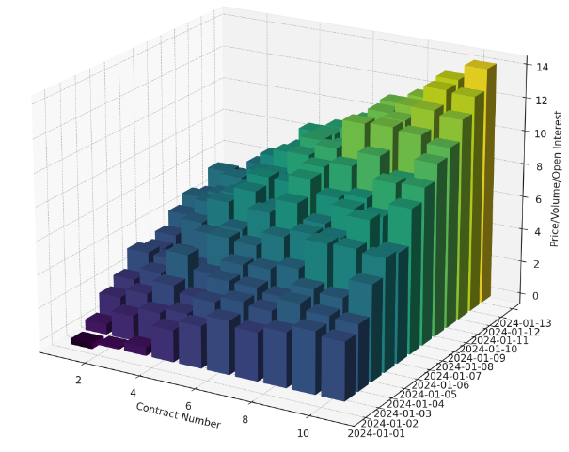
Data processing.
Every input data has to be a picture.
10 pictures:
Price daily/monthly
Volume daily/monthly
Open Interest daily/monthly
3 sentimental pictures from ravenpack
Bit image to indicate if the first contract is tradable. (Alpha Go inspiration)
For instance, from price the features Carry, momentum can be made
But also between images.

Slide 11
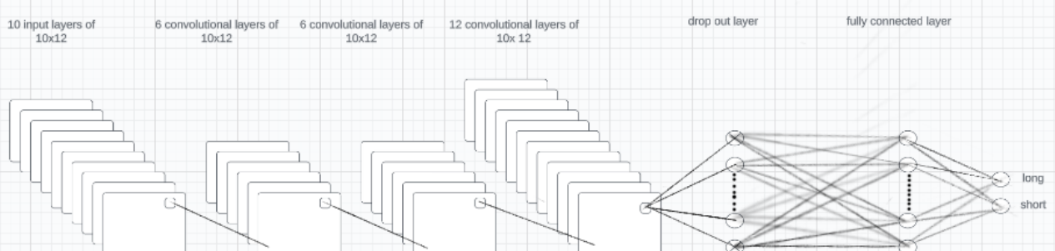
CNN architecture
No pooling layers, main difference from all other papers.
Alpha go also no pooling

Slide 12
Making a Random Forest of CNN models
Dilemma:
It would be nice to tune to the latest available years, but this would also mean the model could not learn that information specifically.
But taking multiple periods in the validation set would result in a lot of data that overlaps partly with the training set.
The best solution I came up with is a mixture of RF and cross validation. Where each tree is a model with the exact same features, but with a varying validation set.
This gives us 10 different CNN trees for our forrest, that each have 2 years of validation data.
Each tree will predict what worked best in its time frame.

Slide 13
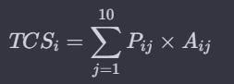
From Prediction to Portfolio
In our approach, each commodity is subjected to a series of ten distinct predictions. These predictions are then multiplied by their corresponding accuracy scores from the validation set.
This multiplication is based on our observation of a positive correlation between validation accuracy scores and test accuracy scores in backtesting.
The total certainty score(TCS) of a commodity contract position(i):
P is the prediction of the CNN
A is the Accuracy of the validation model
This score quantifies the confidence level of
the model in its prediction.
The TCS of all commodities are then scaled to have an absolute sum of 6.

Slide 14
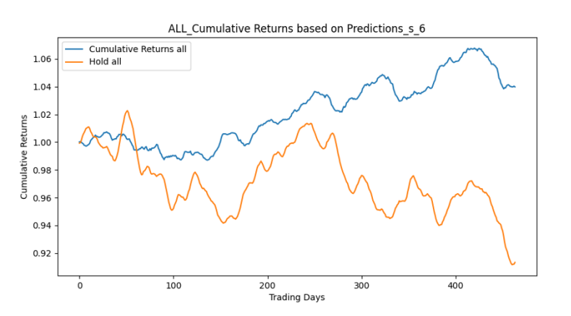
Results Backtests
We compare our strategy with the hold strategy
(returns of going long on all listed commodities for the entire period.)
Both have a leverage of 1 for fair comparison.
1/1/2018 - 31/12/2019.
Our return: 4%
Hold return: -8%
The Sharpe ratio of our strategy over this period is 1.43. with a drawdown of only 2%
(Backtests are unscaled)

Slide 15
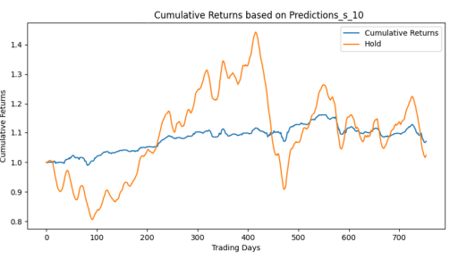
Results Backtests
We compare our strategy with the hold strategy
Both have a leverage of 1 for fair comparison.
1/1/2020 - 31/12/2023.
Our return: 8%
Hold return: 1%
The Sharpe ratio of our strategy over this period is 1.64. with a drawdown of only 3%
(Backtests are unscaled) a drawdown of only 3%

Slide 16
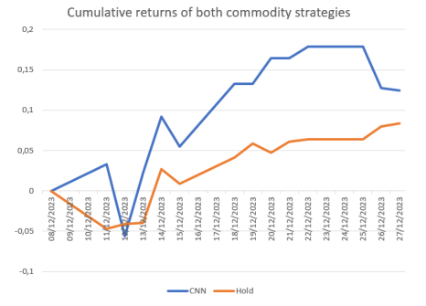
Results Paper trading
Outperforms holt.
High volatility (leverage 6)
Somewhat correlated with hold
12.5% returns in 19 days

Slide 17
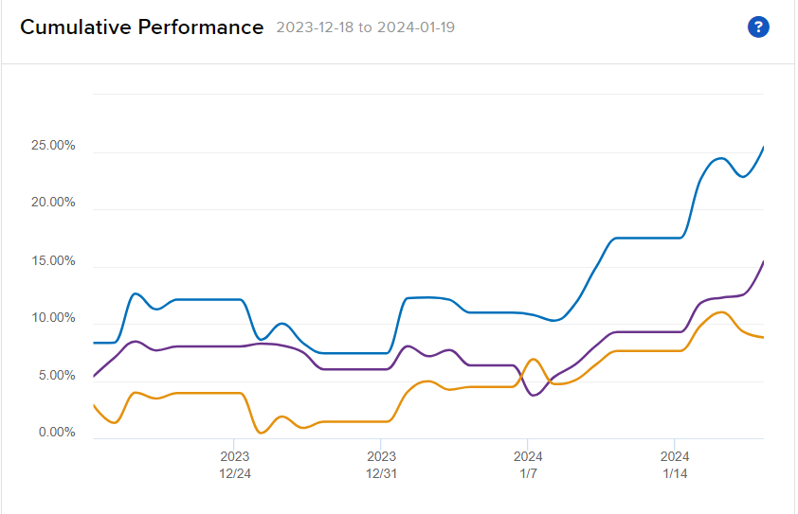
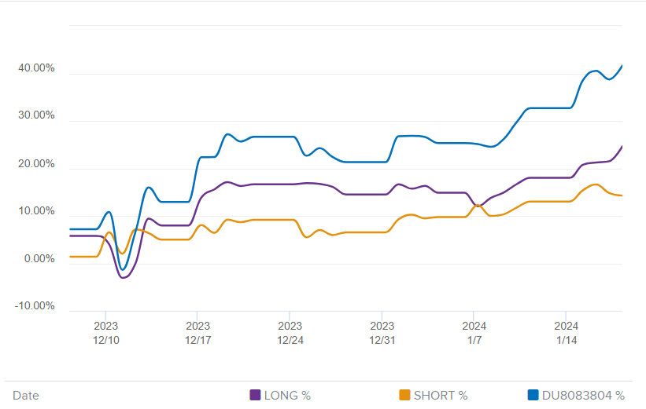
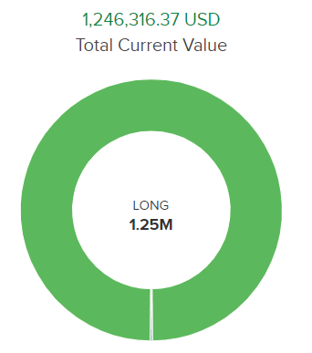
Trades are still open
This suggests the correctly predicted signals carry on longer than 2 weeks
Long and short correct
>40% return

Slide 18
Further research and improvements
More commodities
More history images (like the same month last year).
Risk metric loss instead of return based loss.
Before 2012 market was different.
One off events, example:
Big drop if china bans silver, used for usd exposure, not predictable by model, or very hard, as there is no generalisable data that shows the same one off events.
Balanced, lower risk, as much long as short, not overly exposed.

Slide 19

Most important decision for future work
The most important choice is, do we:
Append all commodity data into one network? Possibility ResNets
Fine tune networks to make them commodity specific?

Slide 20

Questions?

